Slide 1
Sparx Reader
What is Sparx Reader? Sparx Reader helps every student to read regularly, which is vital for building literacy skills. Your children will be completing weekly reading homework using Sparx Reader.
How does Sparx Reader work? Students can choose from a range of ebooks at their appropriate level and as they read, they’ll answer questions to check they’re reading carefully. As they read, they answer questions and earn Sparx Reader Points (SRP) for reading carefully. These points will complete their homework task.

Slide 2
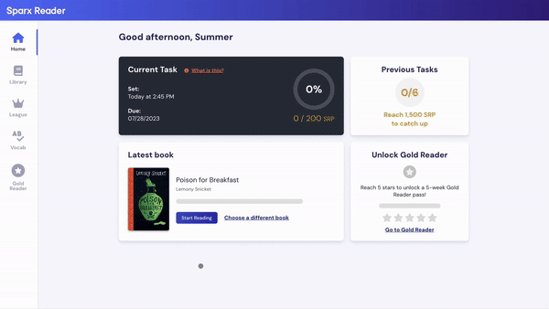
Sparx Reader
This video shows an example of what reading on Sparx Reader looks like.
Sparx Reader adapts to each student’s reading level so book choices and section lengths will differ.

Slide 3
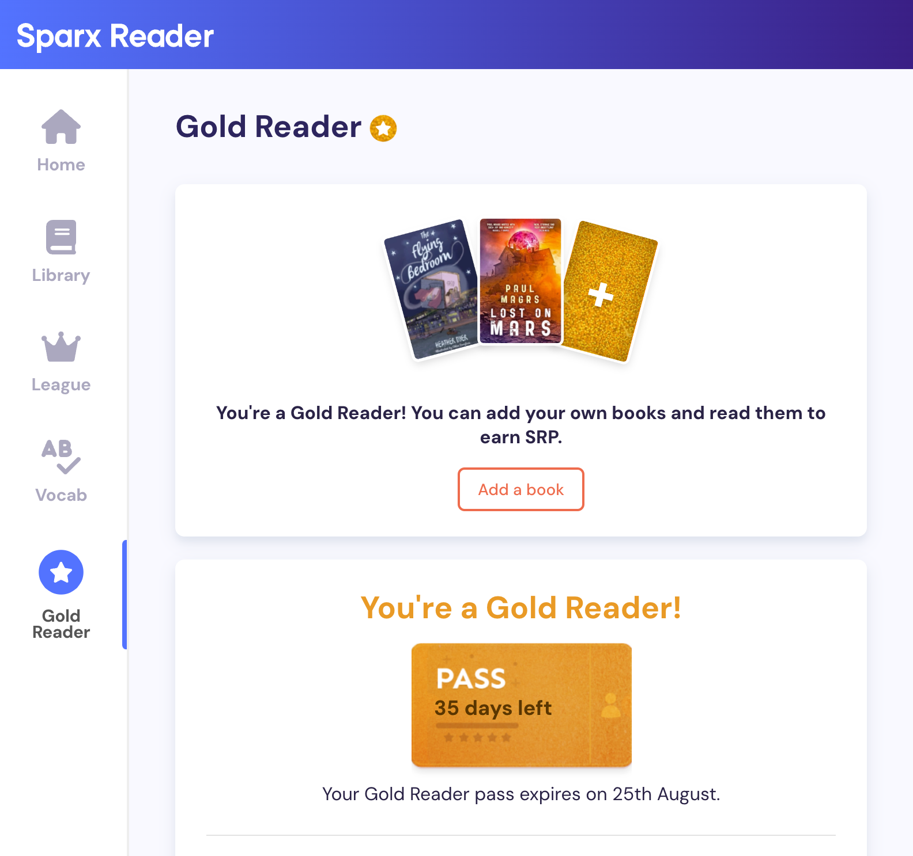
Gold Reader
What is Gold Reader?
Motivated readers who demonstrate consistent, careful reading can unlock Gold Reader.
This means they can read any paper book from the library or from home by scanning in its barcode.

Slide 4
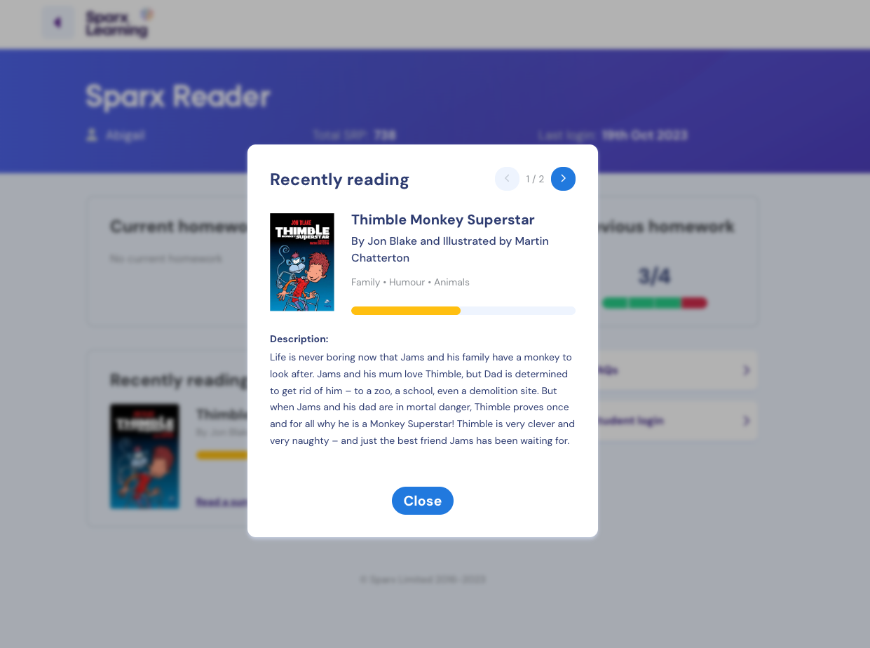
Monitoring your child’s reading
You are able to monitor how your child is getting on with their reading using the link to the Parent Portal, available in your weekly Sparx Maths homework emails. When clicking through the link, you will be able to keep track of any Sparx system that your child uses. Here you can keep track of previous homeworks as well as the book your child is currently reading.

Slide 5
Sparx Reader FAQs
How do they log in?
Students log in at sparxreader.com. They will need to find their school and log in using their Sparx Maths details.
What devices are supported?
Your child can access Sparx Reader on any device that connects to the internet with a web browser.
How can I support my child with their reading?
Sparx Reader adapts to each student’s reading level, so it’s important that you don’t help by answering questions for them. If you help them, Sparx Reader might think they’re a very strong reader and show them books that are too difficult.
You can help by providing a quiet space for your child to focus on their reading homework each week and encourage them to read carefully.
If your child doesn’t like a book, encourage them to keep trying! If they still don’t get on with it, they can give the book a low rating and they’ll be able to swap to another book.
The best way to support your child is to ask them about the book they’re reading; what aspects they’re enjoying, or what characters and events they’ve recently read about.

