Slide 1
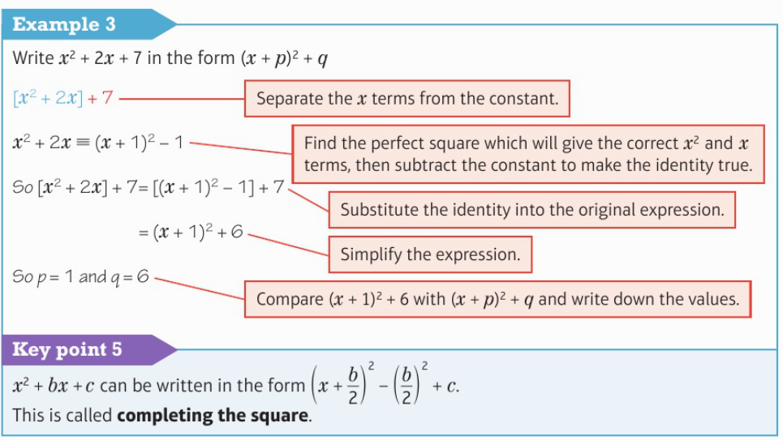
Higher Unit 9 – Equations and Inequalities
Quadratic equations
Quadratic Formula
Completing the square
Enlargements
Reflections

Slide 2
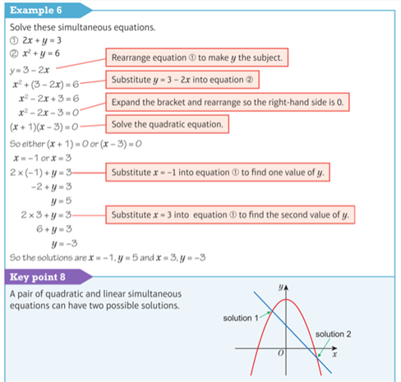
Higher Unit 9 – Equations and Inequalities
Simultaneous
Equations
Linear and
Quadratic
Simultaneous Equations
Inequalities

