Slide 1
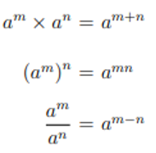
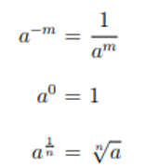
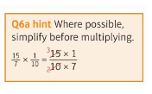
Unit 18 – Fractions, Indices and Standard Form
Addition and Subtraction of Fractions
Multiplication and Division of Fractions
Adding and Subtracting Fractions
Indices Rules
Law of Indices

Slide 2
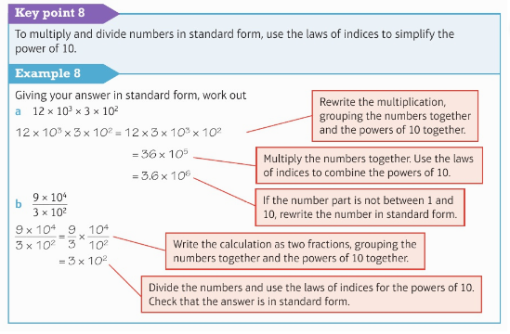
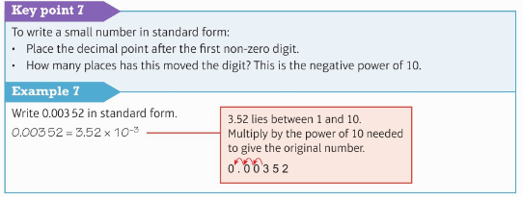
Unit 18 – Fractions, Indices and Standard Form
Standard Form

