Slide 1
Welcome to Microsoft Teams training
Incase of any school closures
To also support blended Learning whilst students are in School

Slide 2
Why Microsoft Teams?
Teams is an advanced & efficient system.
We will be setting you work from now on using teams.
Your teachers can upload their lesson resources for you.
They can set you a quiz which will self mark.
You can upload your work so teachers can give you feedback on your work.
You can work collaboratively on one document with your class.
You can ask your teacher questions and receive extra support.
You can join in to a live lesson or view a recorded lesson by your teacher.

Slide 3
How to access Microsoft Teams
You can download Microsoft Teams for free from your app store for free. Do this on both your phone and a tablet or computer.
To login, you need to use your school login and password:
Email Address: schoollogin@asfaonline.org
Eg if you log in as “phillpsw” in school
It would be phillipsw@asfaonline.org
Password: same as your school password

Slide 4
How does Microsoft Teams work?
This PowerPoint has been created to support you in using Microsoft Teams.
Each slide will have screenshots to show you how to use the different features Microsoft Teams has to offer.
There is also a set of brief instructions on each slide that will guide you step by step through the different features.

Slide 5
Preparing to use Microsoft Teams
So you are able to edit your assignments that your teachers set you through Microsoft Teams, you will have to download Microsoft Word & PowerPoint onto your mobile phones/tablet & computers.
These are available from the App Store or Google Play Store for free.

Slide 6
Live Lesson Etiquette The Rules
When you join a live lesson, you must make sure your camera/webcam is turned off and your microphone is on mute.
You must only use the chat facility on Microsoft Teams to ask your teacher questions or to contribute to an activity during a lesson. All chats are monitored centrally and saved.
Every live lesson will be recorded for pupils to watch if they missed the lesson and it will be made available for pupil viewing after the lesson has finished. It is vital that your webcam is off and you are on mute to avoid disruption during the live lesson. All chats will also be recorded while the lesson is live.
Make sure you are uploading/submitting work in the correct team. It will tell you at the top of your device’s screen what class you are currently in. For example: 9a-IT5-ICT. This will be the same as the class it says on your school timetable.

Slide 7
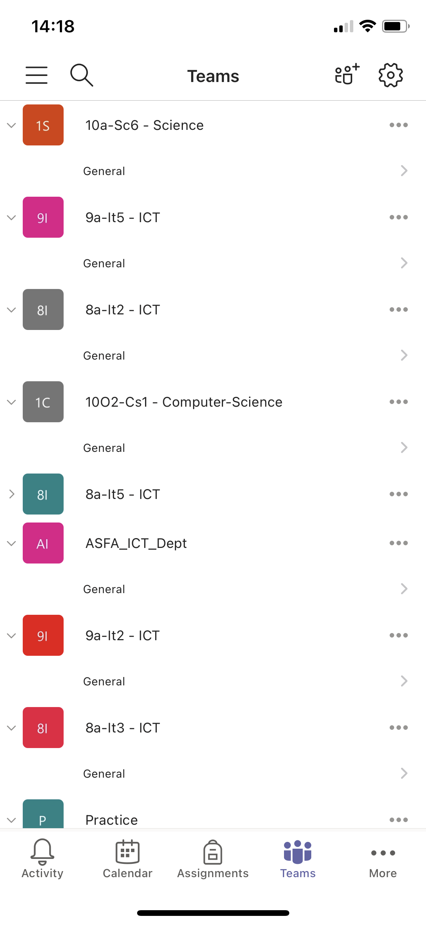
Accessing your teams (classes) dashboard
Click on ‘Teams’ on the bottom toolbar. You should see the class code of every lesson you have on your timetable.
When you click into a team, you will be accessing a virtual classroom. In here, you can join live lessons, find, edit and submit assignments your teachers have set and ask your teacher a question.
To enter the class room, click ‘General’. This should then take you to a different screen

Slide 8
Joining a live lesson
Click on the class that you have a scheduled lesson for. Along the top, click on ‘Posts’.
Your lesson should appear with a calendar icon next to it. Click on this post.
Two options ‘Chat’ and ‘Details’ should appear. When you click Details, you should see the option to ‘Join’
You will have then entered your live lesson.

Slide 9
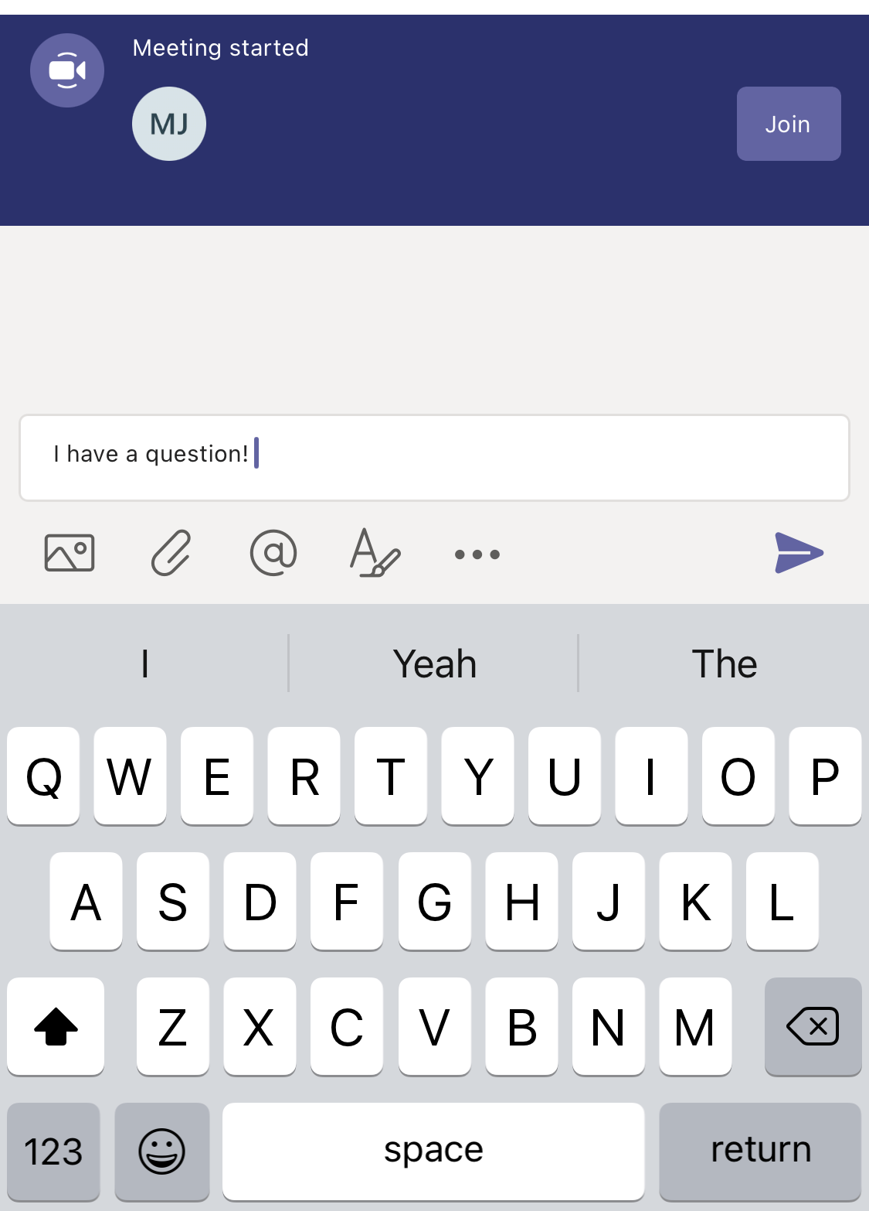
Asking a teacher a question/contributing using the lesson chat
Click once on the screen of your live lesson. You will see a speech bubble. Click on this to access the chat.
You will then be taken to a screen where you will be able to ask a question.
Your teacher may ask you to contribute to the lesson using the chat.
You will also be able to see what your class members are writing.

Slide 10
Accessing your assignments
Select the class you want to access and along the top you should see option such as Posts, Files and More.
Click ‘More’ and select ‘Assignments’
Click on the assignment your teacher wants you to complete. Click the document that is included in the assignment

Slide 11
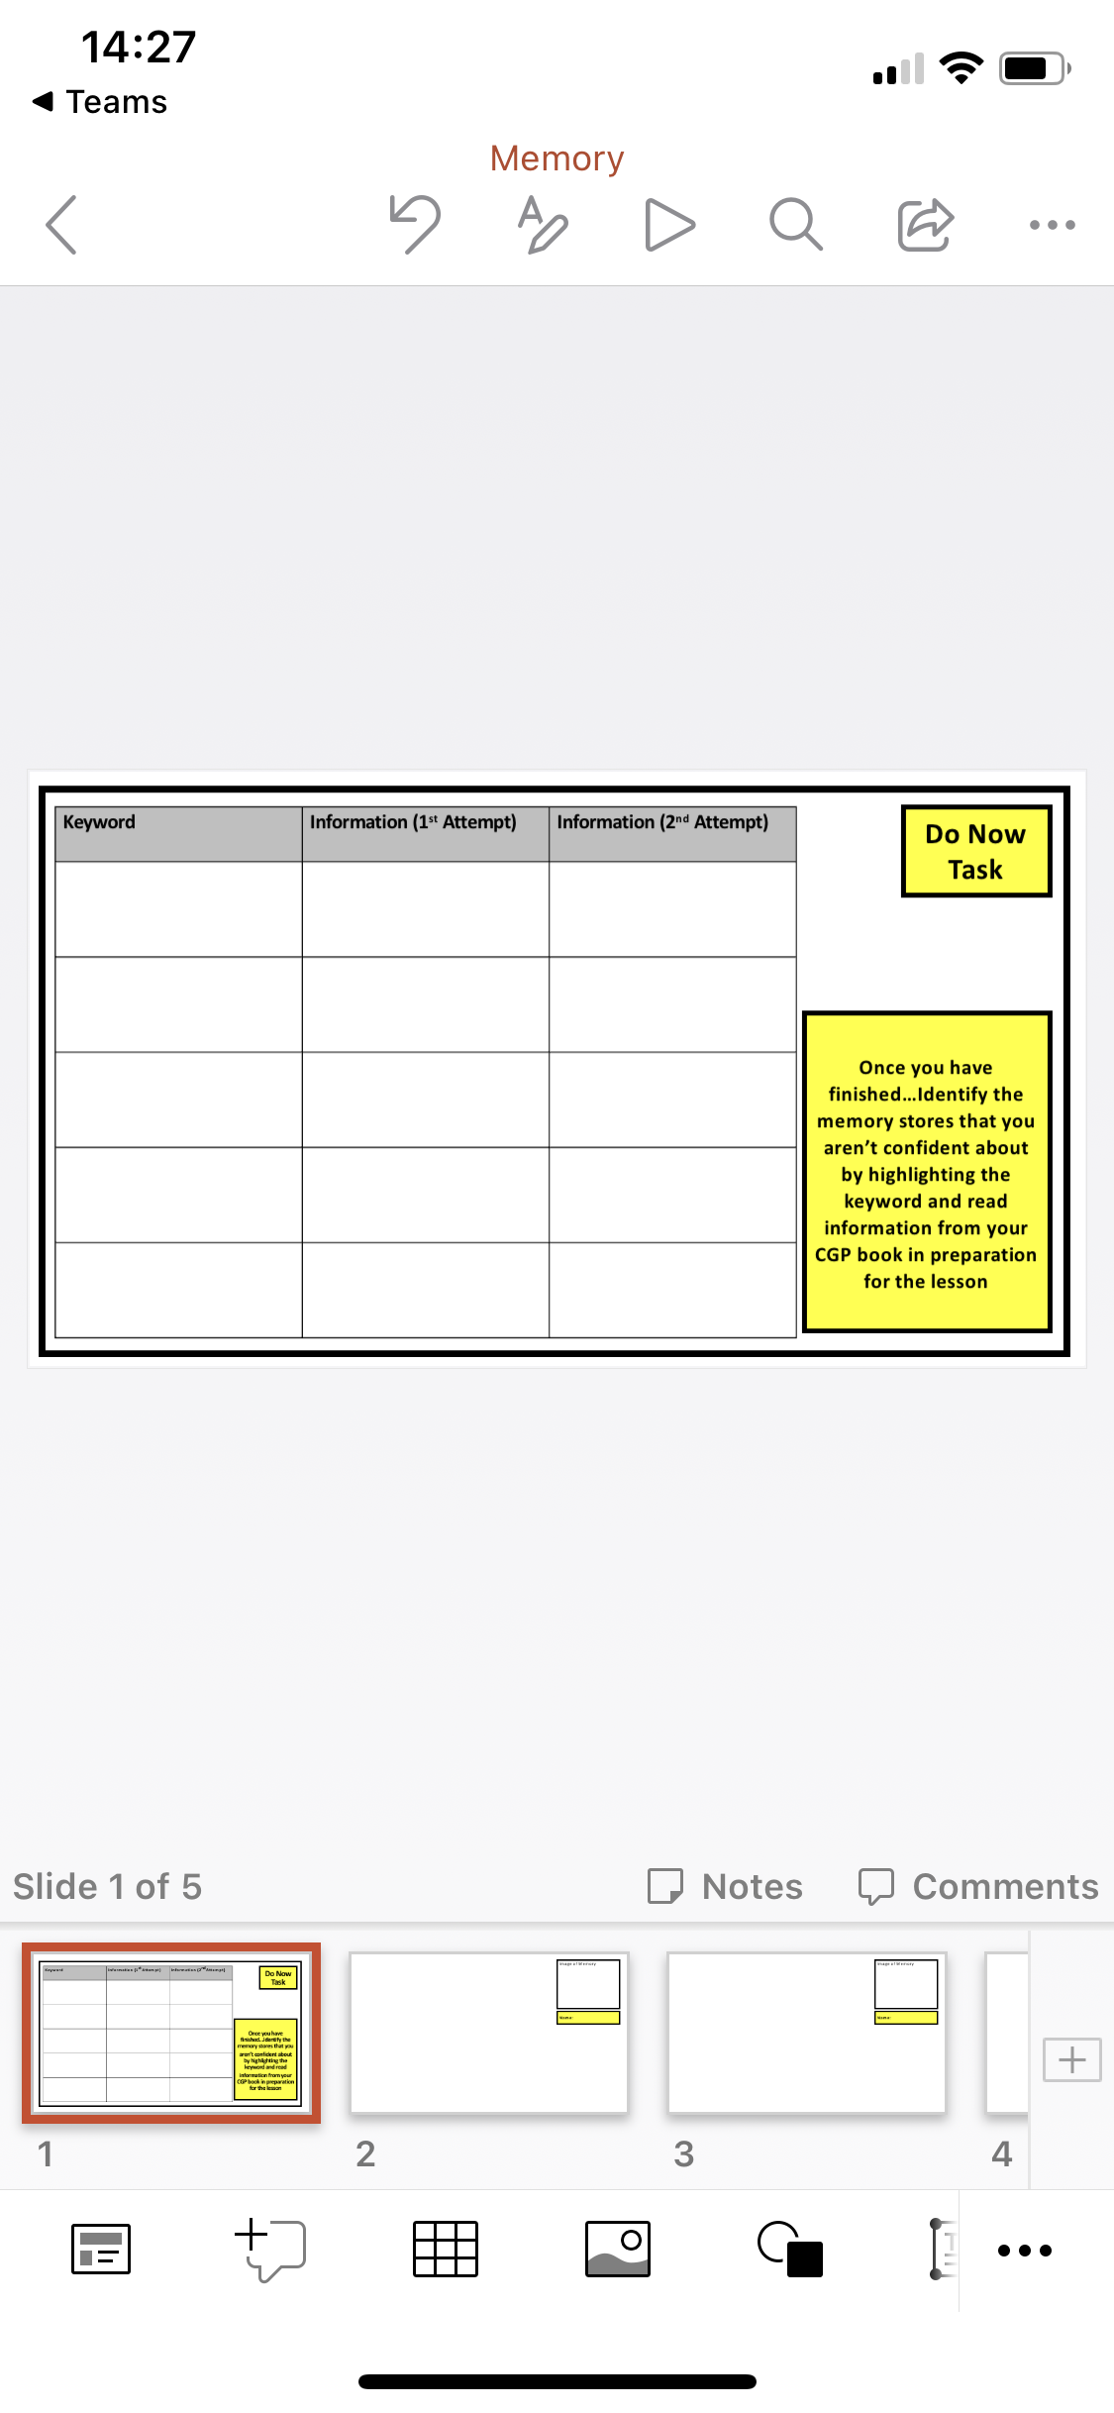
Editing & Submitting your assignments
Once you have selected the assignment you want to complete, you will see a pen and paper icon in the corner of the screen.
To edit the document, click this icon. Your device will take you to the document where you can then edit it. (as long as you have downloaded the Word and PowerPoint app on your phone or tablet)
Once you press the ‘X’ to close the document, you will be able to submit this back to your teacher by pressing ‘Hand In’.
This automatically saves so there is no need to press save.

Slide 12
Accessing Microsoft Team from the Internet
Open Google and type in ‘Microsoft 365’. Select ‘Microsoft 365 Login’.
Login to Microsoft 365 using your school email & password.
Once you see the icons on the left hand side, select the purple Teams Icon.
Select ‘Use Web App Version’
Click ‘Teams’ on the left hand side so you can have view of your classes or ‘Calendar’ if you want to join a live lesson.

Slide 13
Logging out of Microsoft Teams on the Internet
If you are sharing a device with a sibling, you need to log out of your teams account before they can access theirs. You will have different classes and different scheduled lessons so you can’t use the same account.
Along the top bar, click the circle that has your initials in it.
When the options appear, select ‘Sign Out’
This might take a couple of minutes and you should receive a notification that you are logged out of your Teams account.
If you have a sibling waiting to use their team account, they can now log in using their login details.

Slide 14
Adding an additional account on mobile or tablet Teams App
Open your Teams app and press the three lines at the top of the screen.
Select ‘Add Account’ and click ‘Sign in with another account’
You can then login with another school email and password

Slide 15
Next Steps…
Download the apps onto your device (phone, tablet, laptop or PC) – Microsoft Teams & Class Charts
Make sure you can see all of your classes on your dashboard as shown in today’s session
If your teacher has set an assignment, have a go at completing and submitting it using Microsoft Teams
Login to your teams on Friday for your form reflection
Any issues or concerns, go onto the school website and select ‘Teams and Class Charts’. You can then fill out and submit a form which will be sent to the relevant staff in school.

Slide 16
Class Charts
You will need to:
Download the app (if you have a mobile phone) from the App Store or Google Play Store
Login using your details – these will be given out again on Thursday
View your class charts account daily to check for homework and see when it is due
Encourage the adults in your household to download the app to see how you are doing
We will be checking on Monday to see who still hasn’t accessed their Class Charts account

