Slide 1
Hello everyone!
Disclaimer: On slide 3 I discuss this, but do make sure you speak to your parents/carers about whether they are happy for you to watch this series, before giving it a go ☺
Please hover your mouse over the speaker to play sound clips for instructions, discussion and commentary – top left of each page
Read each slide and listen to all of my comments before you start watching the series ☺
If you would like feedback on your final piece of work or have any questions please email me:
reevesa@asfaonline.org

Slide 3
Notes:
https://www.bbc.co.uk/iplayer/episodes/p082w992/noughts-crosses?seriesId=p082w9k7

Slide 4
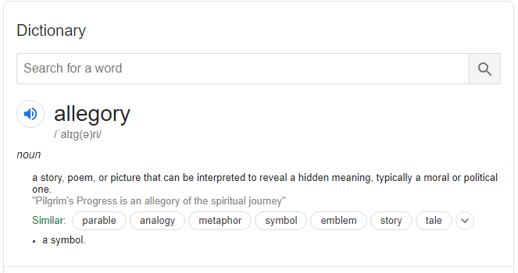

Slide 5
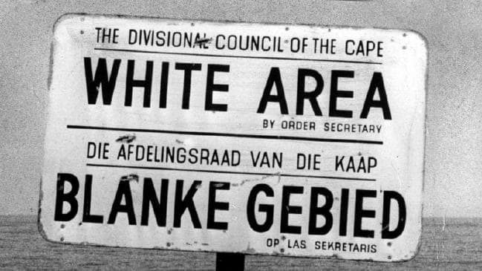
Roots in Reality
Notes:
https://www.historyforkids.net/apartheid.html

Slide 6
Watch this

Slide 7
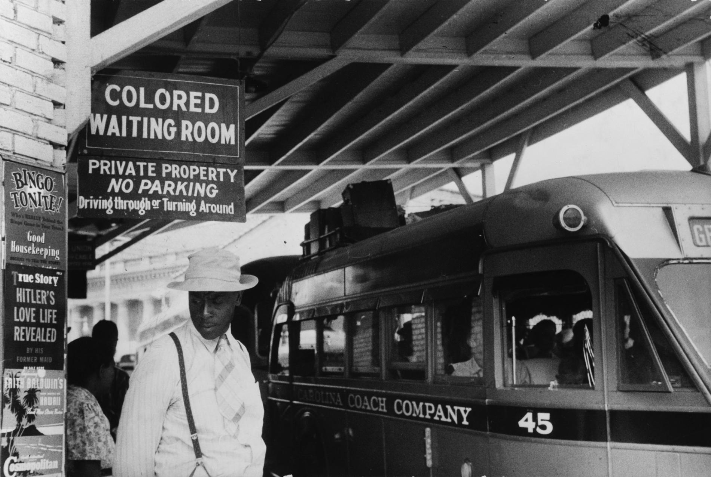
Roots in Reality

Slide 9
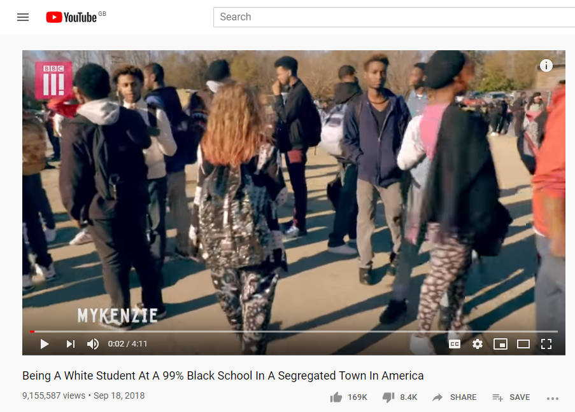
America Today

Slide 15
Notes:
https://www.bbc.co.uk/programmes/p082w992

