Slide 1
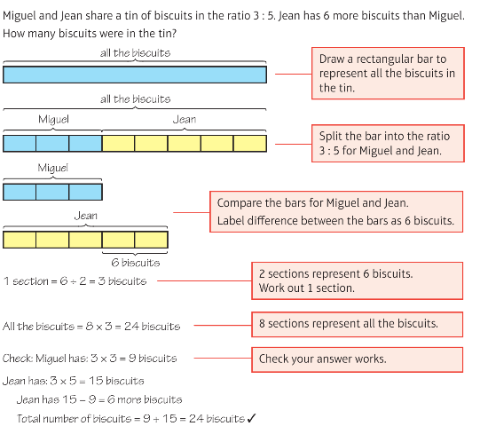
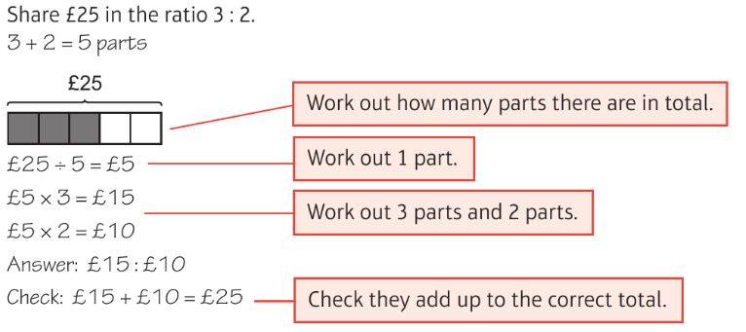
Year 11 Unit 11 Ratio and Proportion
Proportion
Ratio
Ratio Problems
Ratio

