Slide 1
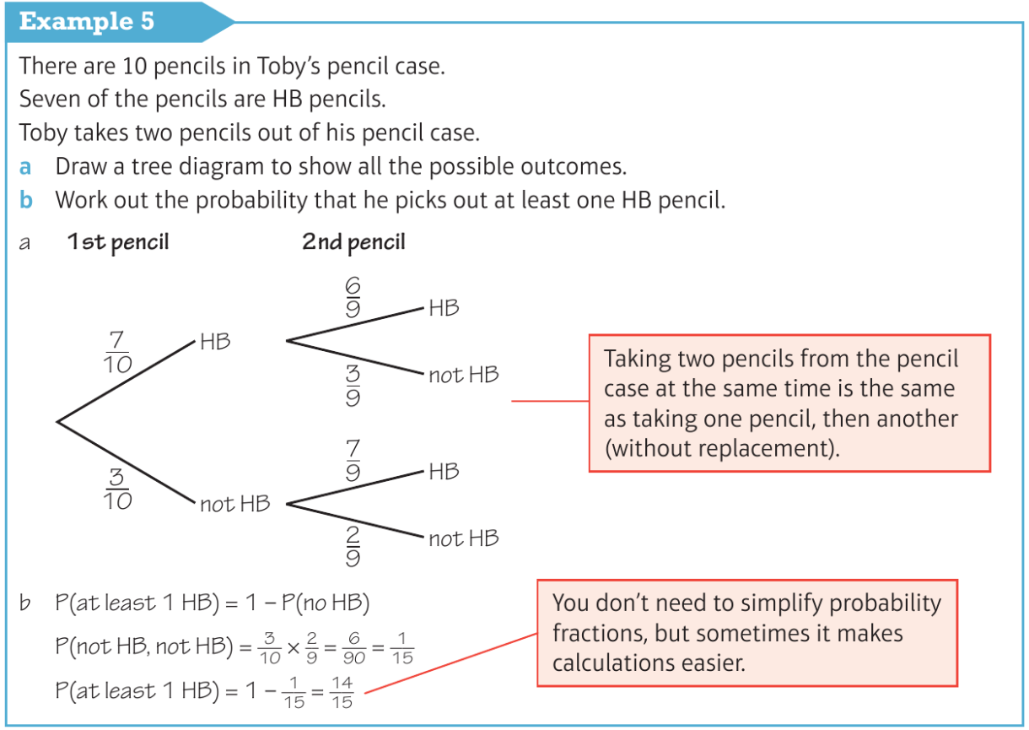
Higher Unit 10 Probability
Mutually exclusive events
Theoretical probability
Sample space diagrams
Conditional probability
Tree diagrams
Venn diagrams

