Slide 1
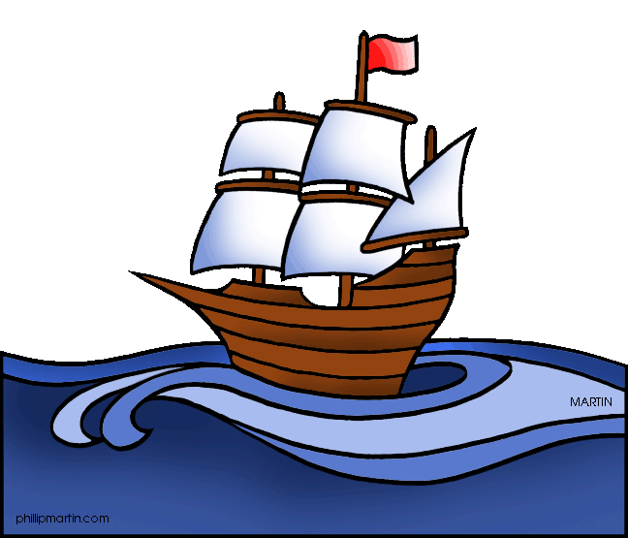
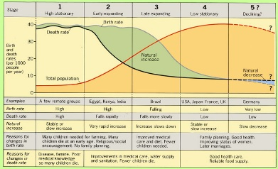
Measuring Development
Development measures how economically, socially, culturally or technologically advanced a country is. It suggests: advancement, evolution, expansion, growth, improvement, increase, maturity, progress, changes for the better.
Development Indicators
GNI | Is an economic measure of development (wealth)
HDI | A social and economical measure of development (GNI, Life Expectancy, Literacy rates)
Infant mortality | A social indicator - Number of babies that die under 1 year of age (per 1000 births)
Literacy rate | A social indicator - Number of people in a country that have basic reading and writing skills
You need to know the advantages and disadvantages of each of these
Factors Causing Uneven Development
Physical Environment | Health
Soil erosion, desertification, climate change, overgrazing and infertile soils affect farming. Areas without fertile land, natural resources, water and energy suffer. Natural hazards make little progress with development e.g. Haiti. | Diseases can make people too weak to work or go to school. 80% of all developing world disease is water-related. 2 million die a year. LIC’s are unable to invest in good quality health care
Trade | History
Trade blocs favour its members. Primary products sold by LIC’s are sold for cheap prices that can fluctuate. HICs make more expensive products so earn more.. Poor infrastructure or conflict means some people cannot sell their goods at all. | Colonialism: Many countries in Asia, S. America and Africa have spent a lot of time and money on civil wars and political struggles for power since being made separate from European superpowers. Many LICs haven’t had time to develop fully.
UK Links
Ports | Air | Roads
UK port industry is the biggest in Europe due to our large coastline 120 ports in UK; Teesport is the 3rd biggest Teesport handles 5000 vessels each year | Heathrow is the Uks busiest airport with 1 plane taking off every 45 secs 300000 people employed in UK aviation Durham Tees Valley airport is looking to expand | 1st motorway in 1958 By 2008 there were 2200 miles of motorways The A1 is the longest road in the UK and connects Teesside The A19 is getting improved
UK Global Links
Political | Commonwealth These are 53 states across the world that were part of our colonial history Many expats live there (Brits who live abroad) The Queen is head of state in 16 of these countries promotes democracy, good governance, human rights and economic development as the UK trades with its previous colonies EU We joined the EU in 1979 and opted to leave in 2016. About 50% of exports and imports are to the EU It’s now a bit confusing as we go through the Brexit process about what will happen to EU laws that we have.
Trade | 49.6% of the UK’s exports went to EU countries, and 50.4% went to non-EU countries such as the USA and China,. The USA takes the most. A lot of trade is now finance and communications following deindustrialisation.
Transport | More than 750,000 international flights depart from the UK annually to 400 airports in 114 countries Heathrow is the 4th busiest airport in the world (good seeing as we’re not the 4th biggest population!) Eurotunnel links our island to Europe
Culture | English Language has helped us set up strong links Students abroad can sit British exams UK TV productions have a global audience We are a culture of immigration leading to a unique and multicultural society
Technology | 90% of population has internet – very connected! We spend more online shopping than anywhere in Europe 18 million businesses run from home
Classifying the World’s Development
 | A HIC has an GNI per capita of over ~$12000 A NEE has an economy that is rapidly progressing A LIC has a GNI per capita of below $800 Many years ago, Dr Brandt classified the world into the rich north and the poor south. He drew this line called the Brandt Line or the North-South Divide. However over time, countries in the south began to develop like Singapore and China and the line became outdated.
Unit 2 – Section B
Changing Economic World
Solutions to Uneven Development
TNCs | Aid
Industrial Development | Intermediate Technology
Fair Trade | Debt Relief
Microfinance | Tourism
CASE STUDY: Tourism in Jamaica
Background: Jamaica is an island in the Caribbean Sea, within the tropics. It receives around 1.5 million tourists a year, and is the most popular tourist destination in the Caribbean | Attractions: You can visit Bob Marley’s house, there is also the 3 mile Negril Beach which offers snorkelling, fishing and water sports. There are also the Blue Mountains National Park with 800 plants and 200 bird species
Positive Impacts: | Negative Impacts
Economic – Businesses provide employment for locals, tourist workers gain skills for other jobs, and taxes paid by businesses allow Jamaica to develop Social – Cultural understanding of Jamaica and its people Environmental – Tourists can be educated on how to look after environment. Ecotourism. | Economic – only 15% of profits stays in the country; the rest goes to HICs. Less tax is paid (economic leakage) The jobs are seasonal. Social – local people can be offended by dress ware that’s considered inappropriate. Environmental – beach erosion, damage to coral reefs by water sports, wetlands drained to make room for hotels
SoL/QoL
Standard of life refers to the economic level of a person’s daily life. Quality of life looks at social measures of well being.
Measuring Population
The demographic transition model shows how a country’s population changes as it becomes more developed from subsistence farming cultures to HICs. Population pyramids/structures change over time too – from having a lot of babies and a wide bottom, to good healthcare and more elderly people.
Ecotourism
Ecotourism, is a type of tourism which involves protecting the environment and the way of life of local people. E.g. Tsavo National Park. People camp, they stick to roads and don’t get close to the animals.

Slide 2
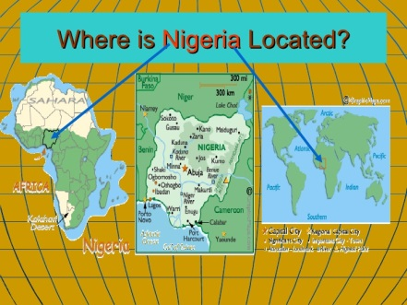
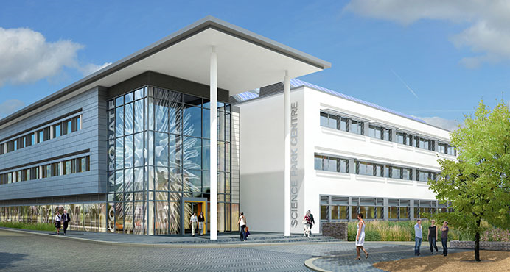
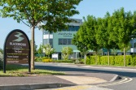
CASE STUDY: Economic and Industrial Change in Nigeria
A Newly-Emerging Economy (NEE)
Nigeria is experiencing a period of rapid economic development. It is the largest economy in Africa. In 2014 Nigeria became the world’s 21st largest economy. Nigeria supplies 2.7% of the world’s oil – the 12th largest producer. Politically, Nigeria has a significant global role. It currently ranks as the 5th largest contributor to UN peacekeeping missions around the world. It has a population of 178 million people – the largest population of any African Country
Trade | Manufacturing and Economy
Nigeria’s main exports are crude and refined petroleum, natural gas, rubber, cocoa and cotton. It’s main trading partner until recently was the USA but now India is its biggest customer and sales to China, Japan and South Korea have increased by 40%. Australia and Indonesia are the biggest customers for Nigerian Cotton. The only significant trading partners they have in Africa are Ghana and Ivory Coast. | In the past, growth in manufacturing was hindered by Nigeria’s dependence on the export of raw materials where processing was mostly done abroad. Today, manufacturing accounts for 10% of Nigeria’s GDP. Among goods produced are: processed foods, textiles, leather items, soaps and detergents. Regular paid work now gives people a more secure income and provides an even-larger home market for purchasing products such as cars and electrical goods
TNCs in Nigeria: Shell
Workers are cheaper in Nigeria than the UK or Netherlands ones would be. They employ 65,000 Nigerian workers and a further 250,000 jobs in related industries.. Despite the benefits, development has caused tensions and environmental problems. Oil spills have caused water pollution and soil degradation, reducing agricultural production and fishing yields. Frequent oil flares send toxic fumes into the air. Oil theft and sabotage are big problems in the region.
Aid to Nigeria
Almost 100 million people (60%) live on less that US$1 a day. Birth rates and infant mortality rates are high. Nigeria receives nearly US$5000 million in aid from countries such as the UK, USA and the World Bank. The most successful projects are community-based by small charities and NGOs.
The Impacts of Social and Economic Change in Nigeria
Social | Environmental
Most indicators show an improving trend HDI is steadily increasing, one of the highest improvements in the world over the last decade Improvements are expected to continue but it must be remembered that 60% of Nigeria’s population still live in poverty. | Industrial growth has lead to major air pollution causing respiratory and heart problems. Urban growth has created squatter settlements and waste disposal is a major problem Deforestation has led to destroyed habitats and added to CO2 emissions.
Economic and Industrial Change in the UK
De-industrialisation is the decline in secondary (manufacturing) industries, and the subsequent growth in tertiary and quaternary employment
The UK has experienced de-industrialisation and has changed into a post-industrial economy; with more tertiary and quaternary industries. Secondary manufacturing industries (like the steel around here) has moved to cheaper countries abroad (e.g. China). | The employment structure for Teesside has changed in the last 50 years due to the loss of employment in iron, steel and chemical industries as companies such as SSI in Redcar close. In the 1970’s, approximately 50% of people in Teesside were employed in manufacturing. In 2008, just 10% of jobs were based in manufacturing, which has mostly been due to industry closures.
Changing Economic and Industrial South West
Science Parks; Cambridge Science Park
Cambridge Science Park is located next to the M11 and Stansted Airport in the town of Cambridge. It is close to Cambridge University, and employs lots of skilled workers from the University. It is built on greenfield site so that it can expand. It includes biomedical and computer/telecoms companies, and has a health and fitness club! | A science park is a group of scientific and technical knowledge-based businesses, located on a single site. Most of these are associated with universities, in order to use research facilities and employ skilled graduates. There are over 100 science parks located in the UK.
Business Parks; Blackbrook Business Park, Taunton
Taunton is strategically located in the heart of Somerset midway between Bristol and Exeter, and Blackbrook is situated directly off junction 25 of the M5 motorway, around 2 miles from the town centre. It is home to a variety of corporate businesses and public sector organisations e.g. solicitors, architects, banking as well as a nursery, Holiday Inn and Swimming Pool. |  | A business park is an area of land that contains a cluster of different businesses, often located on the edges of towns and cities. This is because land is cheaper there, and more land is available
Rural Changes
Britain is experiencing counter-urbanisation where people move to the countryside in search of a better quality of life away from pollution and overcrowding. This causes commuter villages and areas (e.g. South Cambridgeshire): people live close to their work but drive there by car. This can lead to benefits for the villages or drawbacks:
Growth; South Cambridgeshire Good links to Cambridge and London by rail. High level of employment – around 21 % of the workforce is employed in high tech industries. | Decline; The Outer Hebrides The number of school children is expected to fall over the next few years resulting in school closures It has an elderly population as young people leave to find employment.
Example: In Selwick’s Bay, Holderness
North South Divide
Some parts of the UK are easier to; build and farm due to the landscape but deindustrialisation hit the North worse This means that the South is growing with migrants looking for work
More unemployment in the North (9.9% in NE vs 4.4% in SE) links to poverty (2% higher in North). For every 12 jobs created in the South, only 1 is in the North. Average pay is £4k more in the South and you’ll live on average 2.5 years longer!

