Slide 1
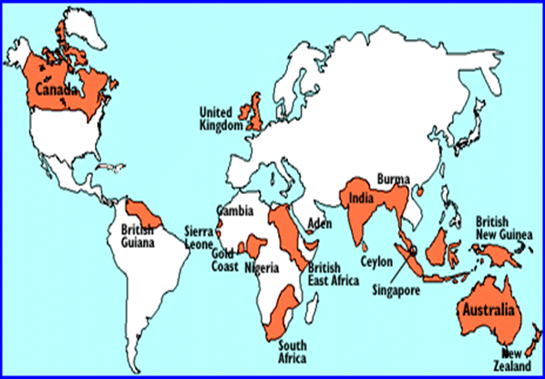
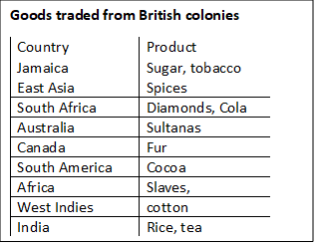
Year 8 History – Unit 2
Revision Sheet – The British Empire
During the 18th century Britain’s empire grew quickly. Britain realised that controlling other countries would help it become wealthier. After 1750 Britain pursued a policy of Imperialism conquering other places like North America, the West Indies, Canada and India. However, in 1783 Britain suffered a setback when the North American colonies broke away from Britain. Despite this, the empire continued to grow adding Australia and most of Africa. By 1900, the British Empire covered one fifth of the world’s land surface.
empire | When one country controls other countries or lands.
colony | An area of land ruled by another country
imperialism | Building up empires.
nationalism | Having pride in and love for your country, willing to defend it (patriotism)
exploration | To travel in order to discover new things
civilise | To educate people and improve their way of life
indigenous | Native people or the first people to live in a place
trade | Buying or selling goods and services with other countries
conquer | To take control of a foreign land by force (war)
settlements | Groups of people would go to different countries to live and build towns
missionaries | People sent to spread Christianity in a foreign country
decolonisation | The process to give colonies their independence
Aboriginal | Name for the indigenous peoples of Australia
dictatorships | A form of government in which a person or group rules with unlimited power
Date | Event | What happened?
1770 | James Cook lands in Australia | The British first visit Australia.
1783 | American War of Independence | America is free from British control. We call this time the end of the ‘First British Empire’. But Britain still has Canada, the West Indies, New Zealand and trading posts in India.
1757 | Battle of Plassey (India) | The East India Company, led by Robert Clive, take control of large parts of India
1770 | Bengal Famine (India) | 10 million people die of famine in Bengal due to heavy British taxation.
1857 | Indian ‘Mutiny’ | An uprising by Indian soldiers (sepoys) in the British Army.
1858 | The British Raj | Control of India is taken away from the East India Company and given to Queen Victoria
1919 | Amritsar Massacre (India) | 379 Indian people murdered by British army after protests break out calling for independence.
1926 | The Commonwealth is formed | The Commonwealth is an alliance of Britain and other countries formerly of the British Empire. They pledge allegiance to the British King or Queen. The Commonwealth is voluntary.
1947 | Indian Independence | India is granted independence.
1956 | Mau Mau Rebellion | War breaks out in Kenya between the Mau Mau, fighting for independence, and the British.
1957 | Ghanaian Independence | Ghana becomes the first African colony to be granted independence.

